Slide 1
Introduction to Java for C++ Programmers
Fundamental Concepts and Classes in Java

Slide 2
Class Declaration in Java
The class declaration in Java has the following format:
class SomeName {
// field(s)
// constructor(s)
// method declarations
}
The class contains all the code you have to write. Your code must be enclosed by curly braces.
The objects’ life cycle is determined by the elements of the class as following:
1. Objects initializations – Constructors
2. Objects states – Fields
3. Class and its objects behaviors – Methods

Slide 3
Creating Objects in Java, Constructors and this, finalize method and garbage collection *
Objects vs. references to objects, primitive data type variables vs. reference type variables
Constructors (default, no-argument), and this
Object Equality (ObjectEquality.java)
Pass-by-value (in Java) vs. pass-by-reference (in other languages like C++)
finalize method and garbage collection
Notes:
A simple and quick refresher:
What is an object? http://docs.oracle.com/javase/tutorial/java/concepts/object.html
What is a class? http://docs.oracle.com/javase/tutorial/java/concepts/class.html
What is a package? http://docs.oracle.com/javase/tutorial/java/concepts/package.html
Objects in Java are created using an expression containing the new keyword: Point lowerLeft = new Point();
All objects are allocated within an area of system memory known as Heap and are accessed only via an object reference. Each Point object is unique and has its own copy of x and y fields.
The Background Garbage Collector
The Java technology garbage collector achieves high performance by taking advantage of the nature of a user's behavior when interacting with software applications such as the HotJava TM browser. The typical user of the typical interactive application has many natural pauses where they're contemplating the scene in front of them or thinking of what to do next. The Java run-time system takes advantage of these idle periods and runs the garbage collector in a low priority thread when no other threads are competing for CPU cycles. The garbage collector gathers and compacts unused memory, increasing the probability that adequate memory resources are available when needed during periods of heavy interactive use.
This use of a thread to run the garbage collector is just one of many examples of the synergy one obtains from Java technology's integrated multithreading capabilities--an otherwise intractable problem is solved in a simple and elegant fashion.
Copyright © 1997 Sun Microsystems, Inc. All Rights Reserved.

Slide 4
REFERENCES
If a and b are references pointing to objects of the same class, what does the expression (a == b) do?
sets a to point to the same object as b
compares the contents of the reference variables themselves
sets b to point to the same object as a
compares the contents of the objects to which a and b refer
Notes:
Ans. 2
a == b compares references
In next lectures we will see that a.equals(b) compares object contents

Slide 5
A second look at the literals
Study Literals.java to learn more about primitives and literals, as well as static vs. non-static fields and how to access them, final vs. non-final fields, and public vs. package fields.

Slide 6
Some important classes in Java: Math, Arrays, and String (vs. StringBuilder/StringBuffer)
Class Math in package java.lang
Arrays are classes in Java; you should create instances (objects) of arrays to work with them.
Default values of arrays in Java, passing arrays to methods, traversing/iterating over 1D arrays, 2D or 3D arrays.
Also, String is a class in Java (SimpleStrings.java). String objects are immutable.
Default values of Strings in Java, passing Strings to methods, and checking String’s API.
StringBuilder: a mutable sequence of characters. This class provides an API compatible with StringBuffer, but with no guarantee of synchronization.
Notes:
Arrays
In contrast to C and C++, the Java programming language arrays are first-class language objects. An array in the Java programming language is a real object with a run-time representation. You can declare and allocate arrays of any type, and you can allocate arrays of arrays to obtain multi-dimensional arrays.
You declare an array of, say, Points (a class you've declared elsewhere) with a declaration like this: Point myPoints[]; This code states that myPoints is an uninitialized array of Points. At this time, the only storage allocated for myPoints is a reference handle. At some future time you must allocate the amount of storage you need, as in: myPoints = new Point[10]; to allocate an array of ten references to Points that are initialized to the null reference. Notice that this allocation of an array doesn't actually allocate any objects of the Point class for you; you will have to also allocate the Point objects, something like this:
for (int i = 0; i < 10; i++) myPoints[i] = new Point();
Access to elements of myPoints can be performed via normal C-style indexing, but all array accesses are checked to ensure that their indices are within the range of the array. An exception is generated if the index is outside the bounds of the array.
The length of an array is stored in the length instance variable of the specific array: myPoints.length contains the number of elements in myPoints.
An array is simply a sequence of either objects or primitives, all the same type and accessed together under one identifier name. Arrays are implicit extensions of Object. Arrays are defined and used with square-brackets indexing operator [ ]:
int[] integerArray = new int[3];
A Java array is guaranteed to be initialized and cannot be accessed outside of its range:
for (int k = 0; k < integerArray.length; k++)
integerArray[k] = k;
Creating an array of objects, one are really creating an array of references, and each of those references is automatically initialized to null:
Student[] room = new Student[3];
An array is actually a container object that holds a fixed number of values of a single type. The length of an array is established when the array is created. After creation, its length is fixed.
Strings
Strings are Java programming language objects, not pseudo-arrays of characters as in C. There are actually two kinds of string objects: the String class is for read-only (immutable) objects. TheStringBuffer class is for string objects you wish to modify (mutable string objects).
Although strings are Java programming language objects, Java compiler follows the C tradition of providing a syntactic convenience that C programmers have enjoyed with C-style strings, namely, the Java compiler understands that a string of characters enclosed in double quote signs is to be instantiated as a String object. Thus, the declaration:
String hello = "Hello world!";
instantiates an object of the String class behind the scenes and initializes it with a character string containing the Unicode character representation of "Hello world!".
Java technology has extended the meaning of the + operator to indicate string concatenation. Thus you can write statements like:
System.out.println("There are " + num + " characters in the file.");
This code fragment concatenates the string "There are " with the result of converting the numeric value num to a string, and concatenates that with the string " characters in the file.". Then it prints the result of those concatenations on the standard output.
String objects provide a length() accessor method to obtain the number of characters in the string.
Java strings are standard objects with built-in language support. The String class represents character strings. All string literals in Java programs, such as "abc", are implemented as instances of String class. Strings are constant; their values cannot be changed after they are
created. StringBuffer class supports mutable strings. Because String objects are immutable, they can be shared.
String str = "abc";
is equivalent to:
char data[] = {'a', 'b', 'c'};
String str = new String(data);
Copyright © 1997 Sun Microsystems, Inc. All Rights Reserved.

Slide 7
ARRAY DECLARATION
Let us suppose that you want to declare, create, and initialize an array in Java. Select all the answers that match:
String[] sa[] = {"s1", "s2", "s3"};
String sa[] = ("abc", "def");
String[] sa = {"1", "2", "3"};
String[] sa = {1, 2, 3};
String sa[] = {"a", "b", "c"};
String[] [] = {'a', 'b', 'c'};
Notes:
Ans. 3 and 5
These are the wrong ones:
String[] sa[] = {"s1", "s2", "s3"}; and String[] [] = {'a', 'b', 'c'}; array of array
String sa[] = ("abc", "def"); parenthesis (); it should be {};
String[] sa = {1, 2, 3}; declare String type and initialize integer

Slide 8
CLASS STRING
Class String has a method: String substring(int a, int b). If you called the method with the intention of returning the substring "XWVU" into String Y from String X which has the value "ZYXWVUTS“, which of the following would be appropriate?
Y = X.substring(3,6);
Y = X.substring(3,4);
Y = X.substring(2,6);
Y = X.substring(2,4);
Notes:
Ans. 3
public String substring(int beginIndex, int endIndex):
beginIndex -- the begin index, inclusive.
endIndex -- the end index, exclusive.

Slide 9
An Array Case study
Study the method isOscilant:
public static boolean isOscilant(int[] arr) {
if (arr.length < 2)
return true;
if (arr[0] == arr[1])
return false;
for (int i = 1; i < arr.length - 1; i++)
if (!((arr[i - 1] < arr[i] && arr[i] > arr[i + 1])
|| (arr[i - 1] > arr[i] && arr[i] < arr[i + 1])))
return false;
return true;
}
What is the result of invoking the above method for arrays [1 2 5 8], [2 3 2], [2 3 -2 7 0 1], and [1 2 1 1 8]?
Notes:
Ans. false (Values are all increasing), true (Down and Up), true (Increasing, Decreasing), and false (Flat part 1 1)
An Approach to call the Array Case Study’s method is given in a later slide

Slide 10
Class Arrays, Command-Line Arguments, and Class Scanner *
Class java.util.Arrays
Command-line arguments (CommandLineArgs.java)
How to input values into your program (Class java.util.Scanner)
Notes:
Next slide uses Arrays.toString() as an example of one of Arrays class’s methods.

Slide 11
Arrays Case Study
Add“import java.util.Arrays;” to the top line of the java file. Create a class including the method isOscilant (slide 9). At last, create a main method as program entry and add the following code into the main method. Could you guess the output?
System.out.println("Check arrays for oscilant: ");
int array1[] = new int[]{1, 2, 5, 8};
int array2[] = new int[]{2, 3, 2};
int[] array3 = new int[]{2, 3, -2, 7, 0, 1};
int[] array4 = new int[]{1, 2, 1, 1, 8};
System.out.println(Arrays.toString(array1) + " is Oscilant: " + isOscilant(array1));
System.out.println(Arrays.toString(array2) + " is Oscilant: " + isOscilant(array2));
System.out.println(Arrays.toString(array3) + " is Oscilant: " + isOscilant(array3));
System.out.println(Arrays.toString(array4) + " is Oscilant: " + isOscilant(array4));
Notes:
Ans. false (Values are all increasing), true (Down and Up), true (Increasing, Decreasing), and false (Flat part 1 1)

Slide 12
Overview of static (or class variables) in Java
Fields that have the static modifier in their declaration are called static fields or class variables.
They are associated with the class, rather than with any object.
Every instance of the class shares a class variable, which is in one fixed location in memory.
Any object can change the value of a class variable, but class variables can also be manipulated without creating an instance of the class.

Slide 13
Overview of static (or class variables) in Java (Cont’d)
Any static variables declared in any class are created …
When the first object of the class is created
When the program which uses the class is loaded
Each time the no-parameter constructor for the class is called
When main() method is executed
Notes:
Ans. When the program which uses the class is loaded
A variable which belongs to the class and not to object(instance)
Static variables are initialized only once , at the start of the execution .
These variables will be initialized first, before the initialization of any instance variables
A single copy to be shared by all instances of the class
A static variable can be accessed directly by the class name and doesn’t need any object.

Slide 14
Relationships between classes (Composition vs. Inheritance), and Nested classes in Java (static vs. non-static/inner, anonymous)
A class definition could contain another class definition besides fields, constructors, and methods (InnerClass.java):
Public class SomeName {
// field(s), constructor(s)
// method declarations
class InnerClass {
// field(s), constructor(s)
// method declarations
}
}

Slide 15
Relationships between Inner and Outer Classes, and Anonymous Class *
An inner class is a nested class whose instance exists within an instance of its enclosing class and has direct access to the instance members of its enclosing instance (Automobile.java).
An inner class without a name is called anonymous class. Anonymous classes enable you to make your code more concise. They enable you to declare and instantiate a class at the same time. They are like local classes except that they do not have a name. Use them if you need to use a local class only once (to be more discussed in future lectures.)

Slide 16
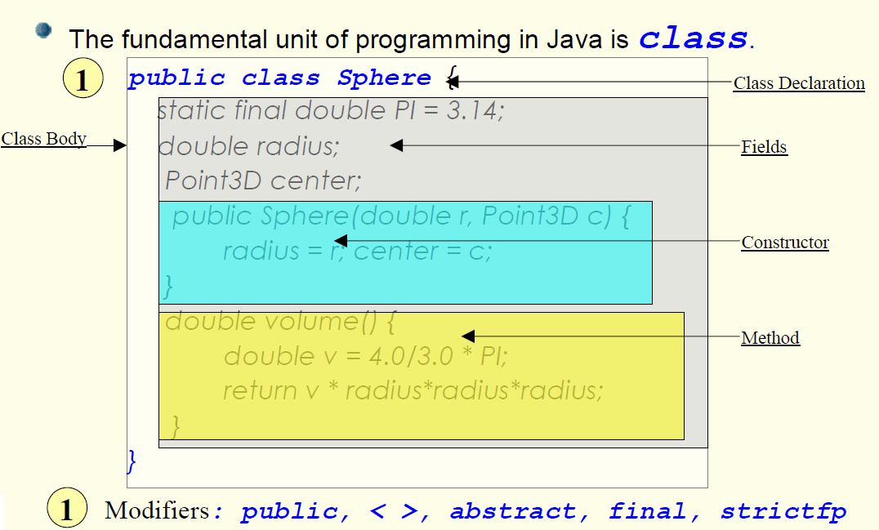
Further Study: Class Structure

Slide 17
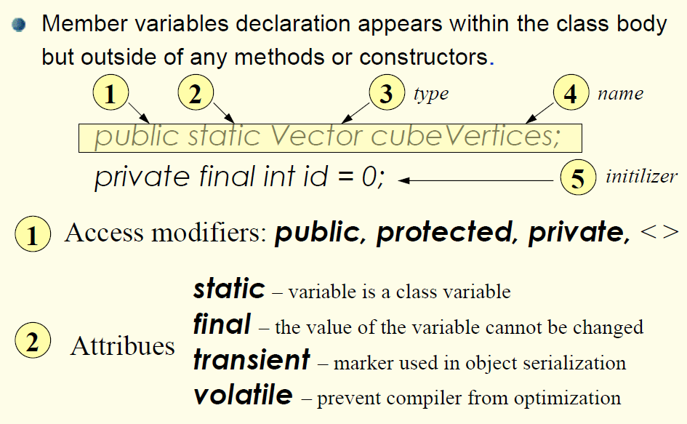
Further Study: Instance/Member Variables (Fields)

Slide 18
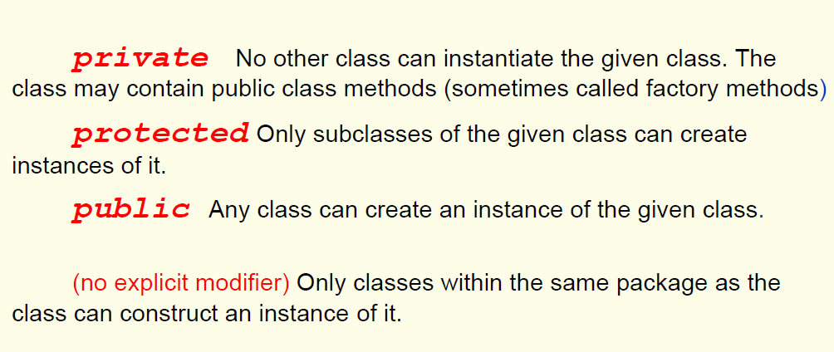
Further Study: Access Modifiers for Constructors

Slide 19
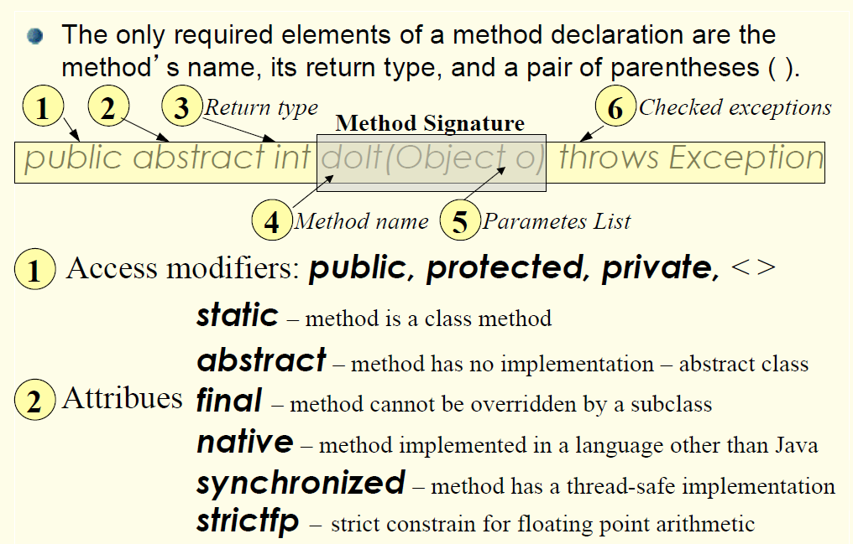
Further Study: Method Declaration

Slide 20
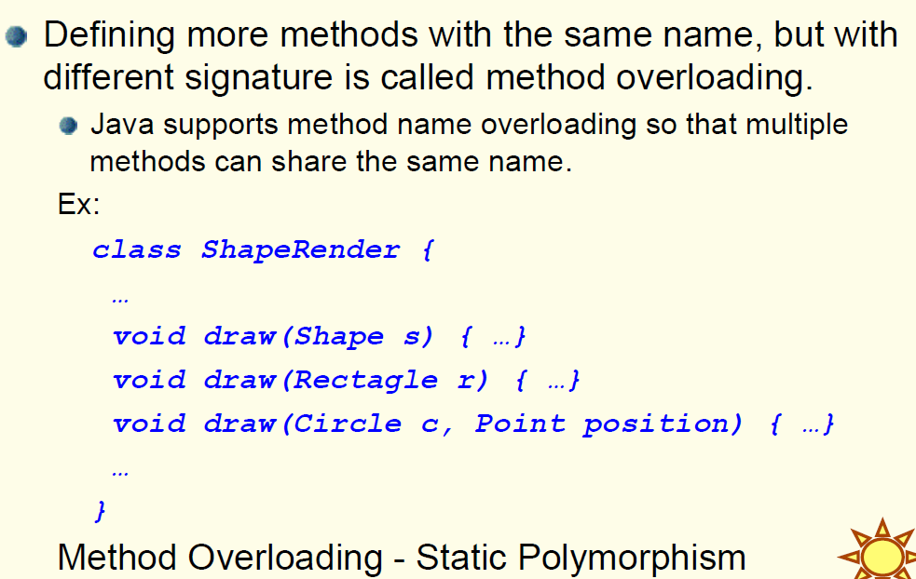
Further Study: Method Overloading

Slide 21
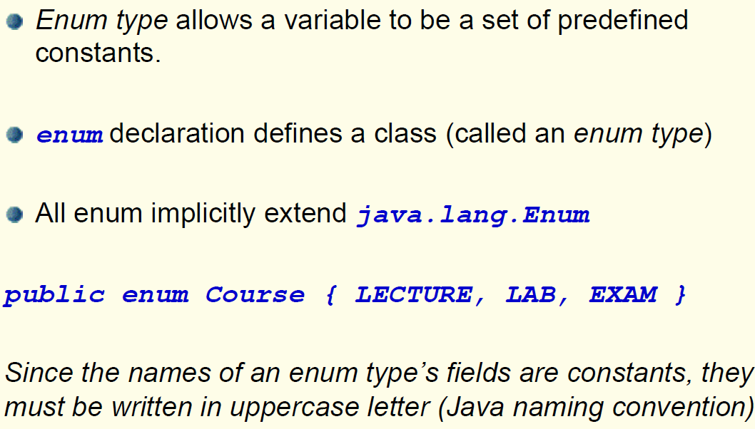
Further Study: Enum Types

Slide 22
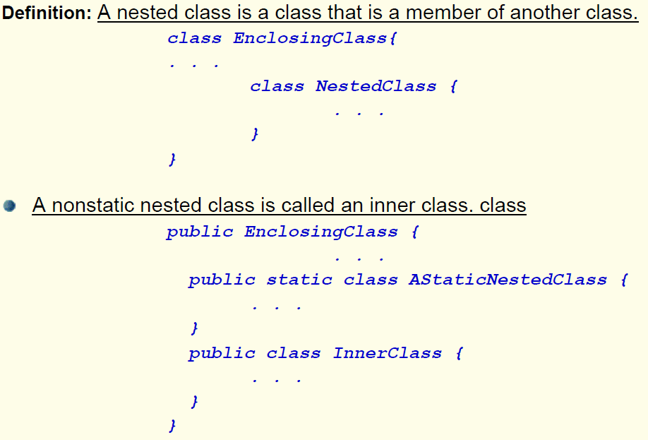
Further Study: Nested Classes

Slide 23
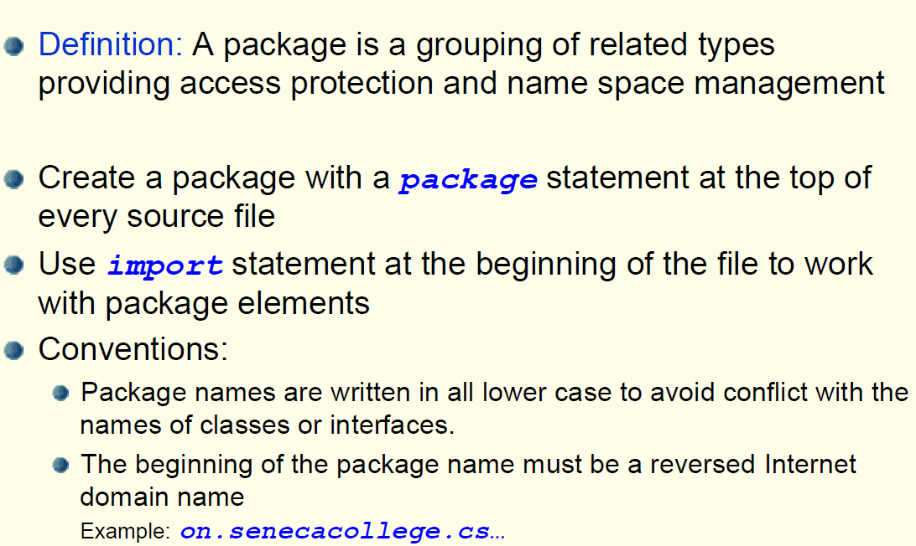
Further Study: Packages

Slide 24
PACKAGE
If a class is NOT a member of a named package, select the answers that match:
It will belong to the default package.
It makes all its data visible to every other class.
It makes all its non-private data visible to all members of the default package.
It will cause a warning at compile time.
Notes:
Ans. 1 and 3

Slide 25
Lab Activities
1- Develop a Java class named BitRepresatation which has at least two private integer fields, one constructor, and one method that takes an integer and prints out its binary equivalent.
In method main(), try to create an instance (object) of the class with two integer values and using the method you have developed, do some bitwise operations on the two integer fields and observe the results.
Also, print out the bit representations of several positive and negative numbers.

Slide 26
Lab Activities (Cont’d)
2- The Fibonacci sequence starts as follows: 1, 1, 2, 3, 5,.... The rules for generating the sequence is: f(1) = 1, f(2 )= 1, and for any k > 2; f(k) = f(k-1) + f(k-2), where f(k) means the k'th Fibonacci number.
Develop a simple Java program that prints out the first 50 Fibonaccis. Compare the results with the non-recursice version of the previous week. What is your observation?

Slide 27
Lab Activities (Cont’d)
3- Given an array of integers, develop a simple Java program that finds the maximum element in the integer array. Note that the array might include negative numbers as well.
(Think about it: what happens if the array is null or empty? what would be your solution?)

Slide 28
Lab Activities (Cont’d)
4- Walkthrough 1: Write down the output of WalkOne.java. Then run the program on your computer. Check if you have got it right. Try to understand the errors that you have made (if any) in predicting the output of the program.

Slide 29
Lab Activities (Cont’d)
5- Walkthrough 2: Working with the code is the best way to learn a new language. There is no "express" way to learn concepts from reading code, but there are a few things you can do. Try modifying the code and focusing on small, localized concepts of the given code, and learning it in little pieces. Don't expect this to happen overnight. It will take some time to understand the intricacies of the new language.
For example: Java is always pass-by-value. It could be hard to understand that Java passes objects as references and those references are passed by value. Write down the output of PassByValue.java. Then run the program on your computer. Check if you have got it right.

Slide 30
Lab Activities (Cont’d)
6- Matrix is a two dimensional array of numbers. We could also say that in Java, a 2D array is an array of arrays. Develop a simple Java program that implements a simple matrix.

Slide 31
Lab Activities (Cont’d)
7- Walkthrough 3: Write down the output of Outer.java and Outer2.java. Then run the program on your computer. Check if you have got it right. Try to understand the errors that you have made (if any) in predicting the output of the program.

Slide 32
Lab Activities (Cont’d)
8- A palindrome is a word, phrase, number, or other sequence of characters which reads the same backward or forward. Stack is a simple data structure/container which acts as LIFO (last element in, would be the first element out).
First, Develop a Stack class. Second, Develop a simple Java program that gets a string as a command-line argument and reverses that string, and then uses the stack to check if the given string is a palindrome.

Slide 33
Lab Activities (Cont’d)
9- Write a class that provides methods to solve the following exercises (The methods must be recursive methods):
1. Write a recursive method that prints numbers from 1 to n in reverse order
example: n, n-1, n-2, ..., 1, 0
2. Write a recursive method that calculates n to the power of p
example: 5 to the power of 3 is 125
3. Write a recursive method that converts a decimal number into binary number
example: 7 in decimal is 111 in binary format
A skeleton in a class named RecursiveExercise.java has been given to you in the files and you must fill out the missing codes marked with /* ??? */

